Slide 1
Controlling Traveling-Wave Phonons at Room Temperature
Joel N. Johnson
April 25th, 2025
Northern Arizona University

Slide 2
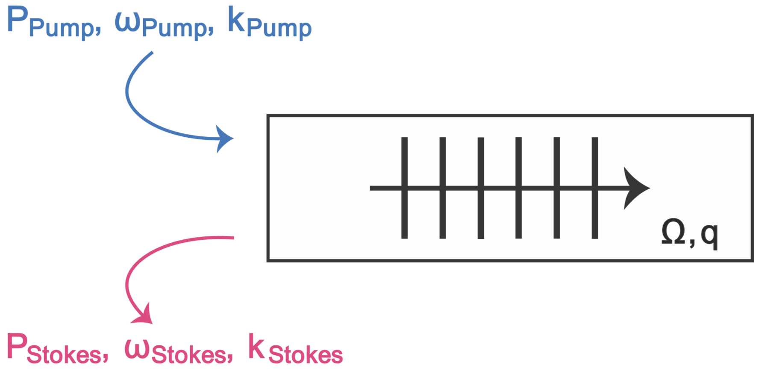
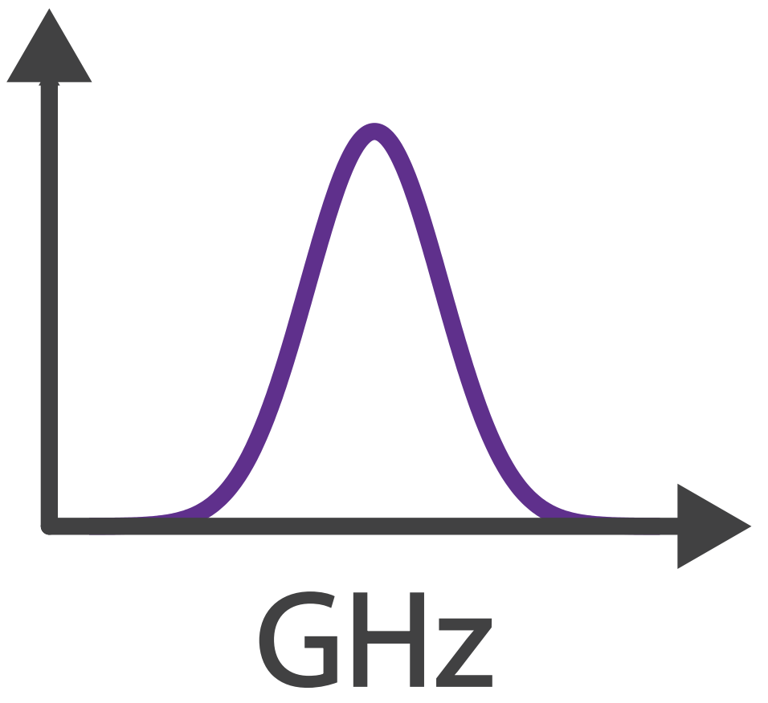
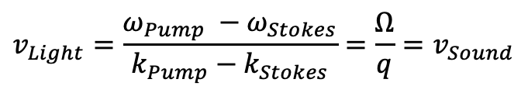

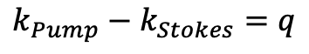
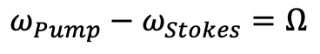
Brillouin Scattering: Optomechanical Coupling
Phase (velocity) matching:
$$v_{Light}=\frac{ω_{Pump} −ω_{Stokes}}{k_{Pump}−k_{Stokes}}=\frac{Ω}{q}=v_{Sound}$$
✓
Energy Conservation:
$$ω_{Pump}−ω_{Stokes}=Ω$$
✓
Momentum Conservation:
$$k_{Pump}−k_{Stokes}=q$$
$$Ω$$

Slide 3
Controlling Sound with Light
Laser Cooling of Traveling-Wave Phonons in an Optical Fiber
Quieting sound with light
Coherently stimulated Brillouin Scattering
Amplifying sound to measure subtle signals
Brillouin-Induced Raman Modes
Harnessing sound for engineered behaviors

Slide 4
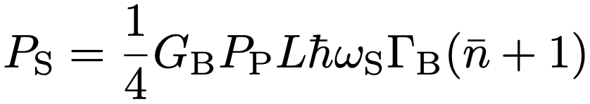
Laser Cooling
Why do we care about laser cooling
noise
Discrete to continuous
Cavities permit discrete mode, tune laser s.t. it’s the anti-Stokes freq
Fast escape condition
4v_{g}/L > Γ₀
Tough because scattered power scales with length
Chip waveguide continuous system
Independent Stokes/Anti-Stokes modes
Geometrically engineered high gain waveguide – 470 W⁻¹m⁻¹
Challenges in fiber
Large enough gain for small enough L for fast escape

Slide 5
Laser Cooling

Slide 6
Optomechanical Cooling
Material at room temperature has thermal fluctuations (phonons)
Ω
phonon

Slide 7
Optomechanical Cooling
Material at room temperature has thermal fluctuations (phonons)
Laser light
Ω
⍵
phonon

Slide 8
Optomechanical Cooling
Material at room temperature has thermal fluctuations (phonons)
Laser light backscatters off approaching sound wave (Brillouin scattering)
Ω
⍵
phonon

Slide 9
Optomechanical Cooling
Material at room temperature has thermal fluctuations (phonons)
Laser light backscatters off approaching sound wave (Brillouin scattering)
Energy transfers from sound to light:
Returning light is frequency upshifted (blue-shifted)
⍵’ = ⍵ + Ω
Ω
⍵
phonon

Slide 10
Optomechanical Cooling
Material at room temperature has thermal fluctuations (phonons)
Laser light backscatters off approaching sound wave (Brillouin scattering)
Energy transfers from sound to light:
Returning light is frequency upshifted (blue-shifted)
Sound wave intensity is lowered (cooled)
⍵’ = ⍵ + Ω
Ω
⍵
phonon

Slide 11
Optomechanical Cooling
Material at room temperature has thermal fluctuations (phonons)
Laser light backscatters off approaching sound wave (Brillouin scattering)
Energy transfers from sound to light:
Returning light is frequency upshifted (blue-shifted)
Sound wave intensity is lowered (cooled)
⍵’ = ⍵ + Ω
Ω
⍵
phonon

Slide 12
Optomechanical Cooling
Material at room temperature has thermal fluctuations (phonons)
Laser light backscatters off approaching sound wave (Brillouin scattering)
Energy transfers from sound to light:
Returning light is frequency upshifted (blue-shifted)
Sound wave intensity is lowered (cooled)
Anti-Stokes
⍵’ = ⍵ + Ω
Ω
⍵
phonon

Slide 13
Optomechanical Heating
Material at room temperature has thermal fluctuations (phonons)
Ω
phonon

Slide 14
Optomechanical Heating
Material at room temperature has thermal fluctuations (phonons)
Laser light
Ω
⍵
phonon

Slide 15
Optomechanical Heating
Material at room temperature has thermal fluctuations (phonons)
Laser light backscatters off retreating sound wave (Brillouin scattering)
Ω
⍵
phonon

Slide 16
Optomechanical Heating
Material at room temperature has thermal fluctuations (phonons)
Laser light backscatters off retreating sound wave (Brillouin scattering)
Energy transfers from light to sound:
Returning light is frequency downshifted (red-shifted)
⍵’ = ⍵ - Ω
Ω
⍵
phonon

Slide 17
Optomechanical Heating
Material at room temperature has thermal fluctuations (phonons)
Laser light backscatters off retreating sound wave (Brillouin scattering)
Energy transfers from light to sound:
Returning light is frequency downshifted (red-shifted)
Sound wave intensity is increased (heated)
⍵’ = ⍵ - Ω
Ω
⍵
phonon

Slide 18
Optomechanical Heating
Material at room temperature has thermal fluctuations (phonons)
Laser light backscatters off retreating sound wave (Brillouin scattering)
Energy transfers from light to sound:
Returning light is frequency downshifted (red-shifted)
Sound wave intensity is increased (heated)
⍵’ = ⍵ - Ω
Ω
⍵
phonon

Slide 19
Optomechanical Heating
Material at room temperature has thermal fluctuations (phonons)
Laser light backscatters off retreating sound wave (Brillouin scattering)
Energy transfers from light to sound:
Returning light is frequency downshifted (red-shifted)
Sound wave intensity is increased (heated)
Stokes
⍵’ = ⍵ - Ω
Ω
⍵
phonon

Slide 20
Cooling Figures of Merit
All materials have a natural rate of mechanical dissipation (Γ₀)
To cool is to increase dissipation rate (Γ₊)
Spectral linewidth gives dissipation rate
Broadened linewidth gives measure of cooling
Γ

Slide 21
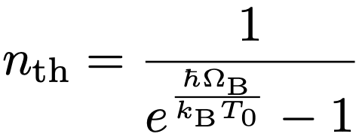
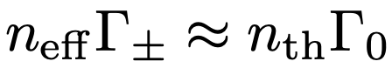
Cooling Figures of Merit

Slide 22
CS₂-Filled Liquid-Core Optical Fiber
carbon disulfide (CS₂) fills the hollow-core of optical fiber via capillary action
1 meter
SMF-28
UHNA7
hollow-core
UHNA7
SMF-28
~1.68 µm

Slide 23
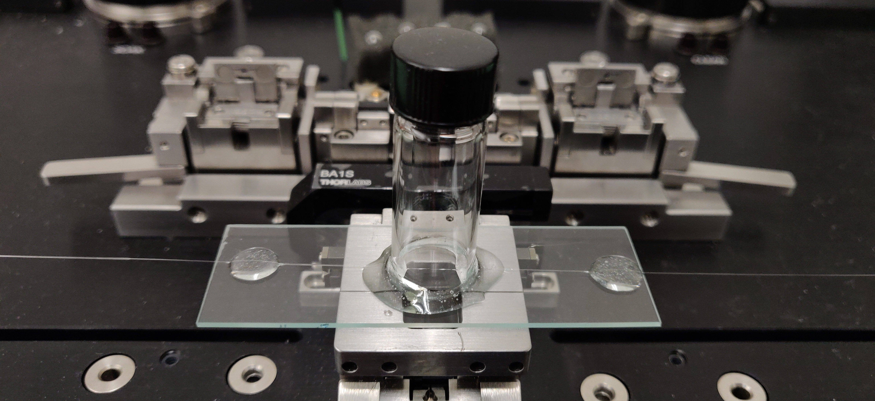
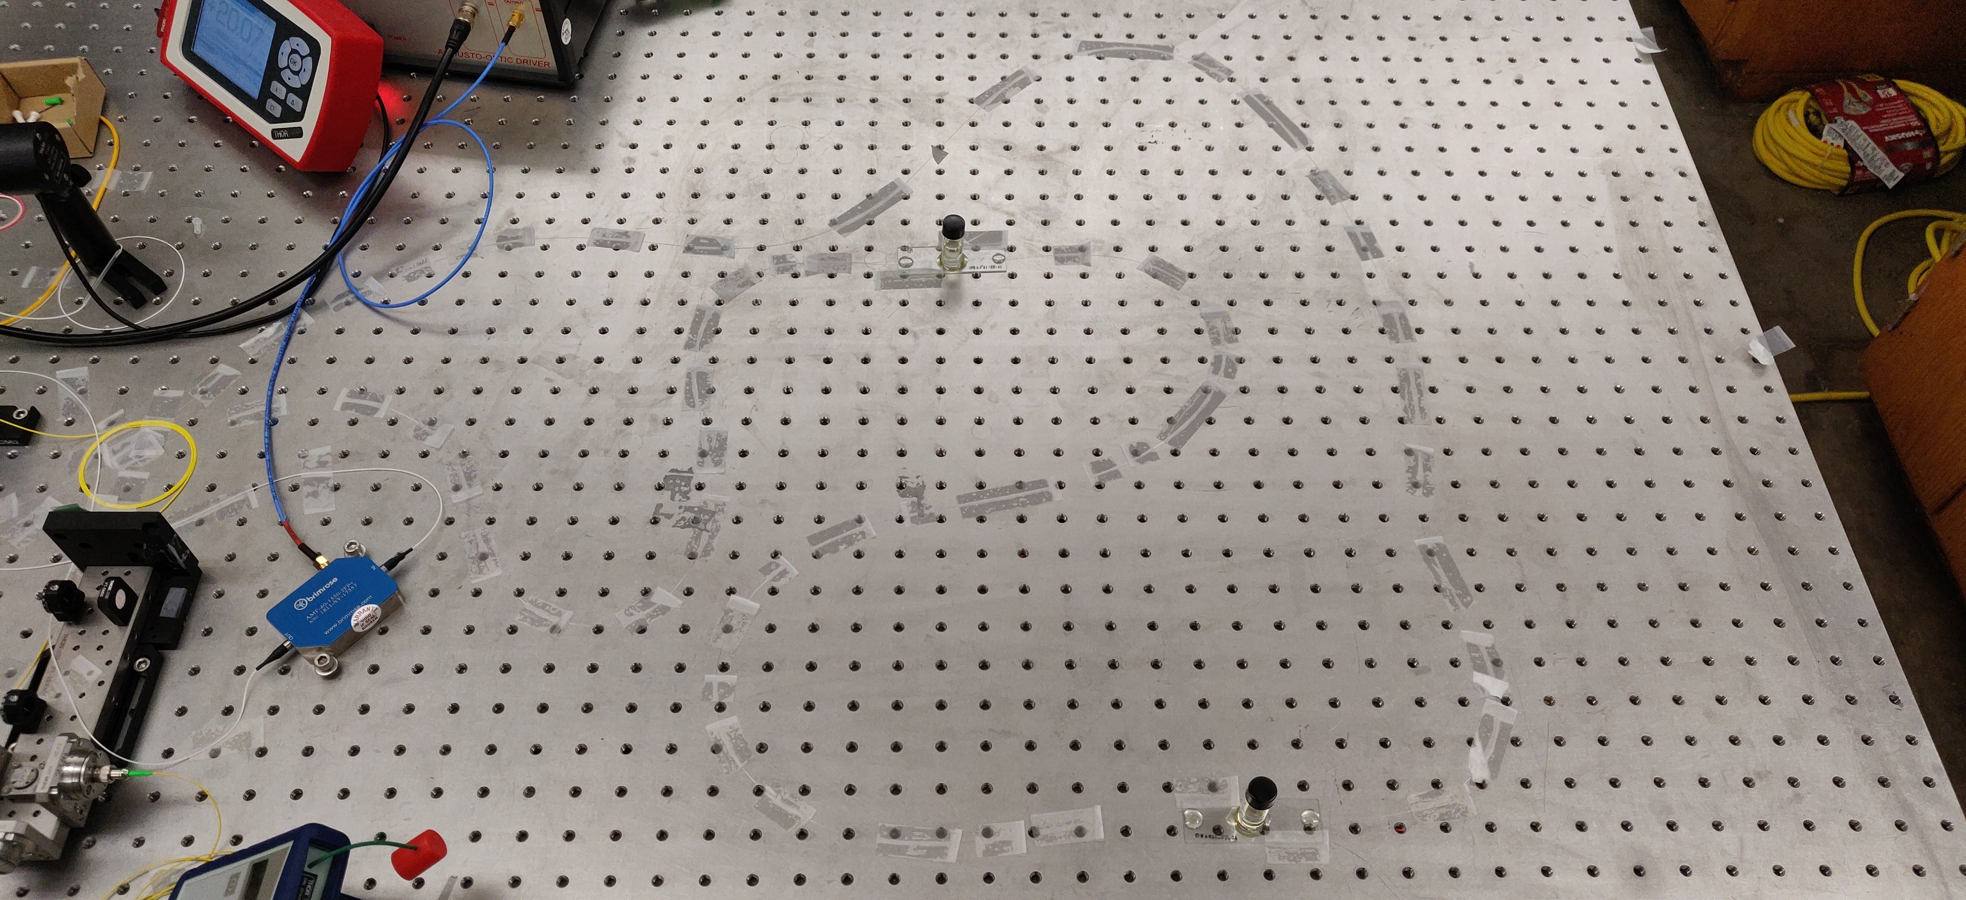
Liquid-core Optical Fiber Sample

Slide 24
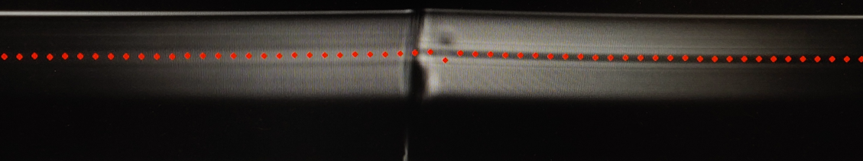
Liquid-core Optical Fiber Sample

Slide 25
Liquid-core Optical Fiber Sample
CS₂ enters here

Slide 26

Liquid-core Optical Fiber Sample
CS₂ enters here

Slide 28
CoBS

Slide 29
Raman

Slide 30
Conclusion
People, organizations, institutions to thank

